Slide 1
Vehicle Analysis Empowering consumers to make informed decisions when purchasing a vehicle

Slide 2
Objectives
Provide a comprehensive analysis of vehicle values for different vehicle makes.
Determine vehicle values of popular vehicle brands over time.
Identify key features that influence a vehicle’s value.

Slide 3

Overview of the Dataset Total Records: 1,874 Vehicle Makes: Audi, BMW, Honda, Hyundai, Land Rover, Mercedes-Benz, Toyota, and Volkswagen Price ranges: $3,000 – $420,000 Locations: Data pertains to vehicles primarily located in India Years: 2017 - 2021 Engine Sizes: 624cc – 6592cc Drivetrains: All Wheel Drive, Front Wheel Drive, Rear Wheel Drive Transmissions: Automatic vs. Manual Fuel Types: Petrol, Diesel, CNG, Hybrid, CNG Hybrid
7794
7794.315789473684

Slide 4
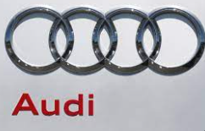







Distribution of vehicle makes

Slide 5
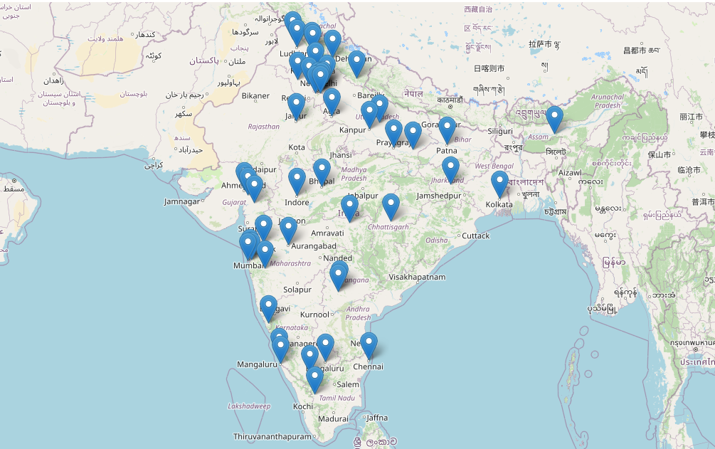
Geographic distribution (75 Countries)
Agra
Ahmedabad
Allahabad
Ambala Cantt
Amritsar
Aurangabad
Bangalore
Bhopal
Bhubaneswar
Bulandshahar
Chandigarh
Chennai
Coimbatore
Dak. Kannada
Dehradun
Delhi
Deoghar
Dharwad
Ernakulam
Faizabad
Faridabad
Ghaziabad
Goa
Gorakhpur
Gurgaon
Guwahati
Haldwani
Hyderabad
Indore
Jaipur
Jalandhar
Jamshedpur
Kanpur
Karnal
Kharar
Kheda
Kolkata
Kollam
Kota
Lucknow
Ludhiana
Mangalore
Meerut
Mirzapur
Mohali
Mumbai
Muzaffurpur
Mysore
Nagpur
Nashik
Navi Mumbai
Noida
Panchkula
Panvel
Patna
Pmpri-Chinchwad
Pune
Purnea
Raipur
Ranchi
Ranga Reddy
Rohtak
Roorkee
Rudrapur
Salem
Samastipur
Surat
Thane
Udupi
Vadodara
Valsad
Varanasi
Warangal
Yamunanagar
Zirakpur

Slide 6
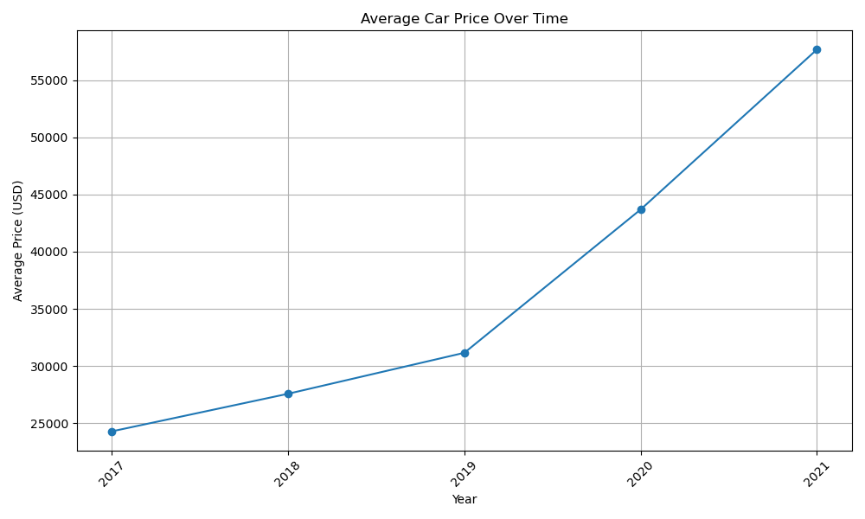
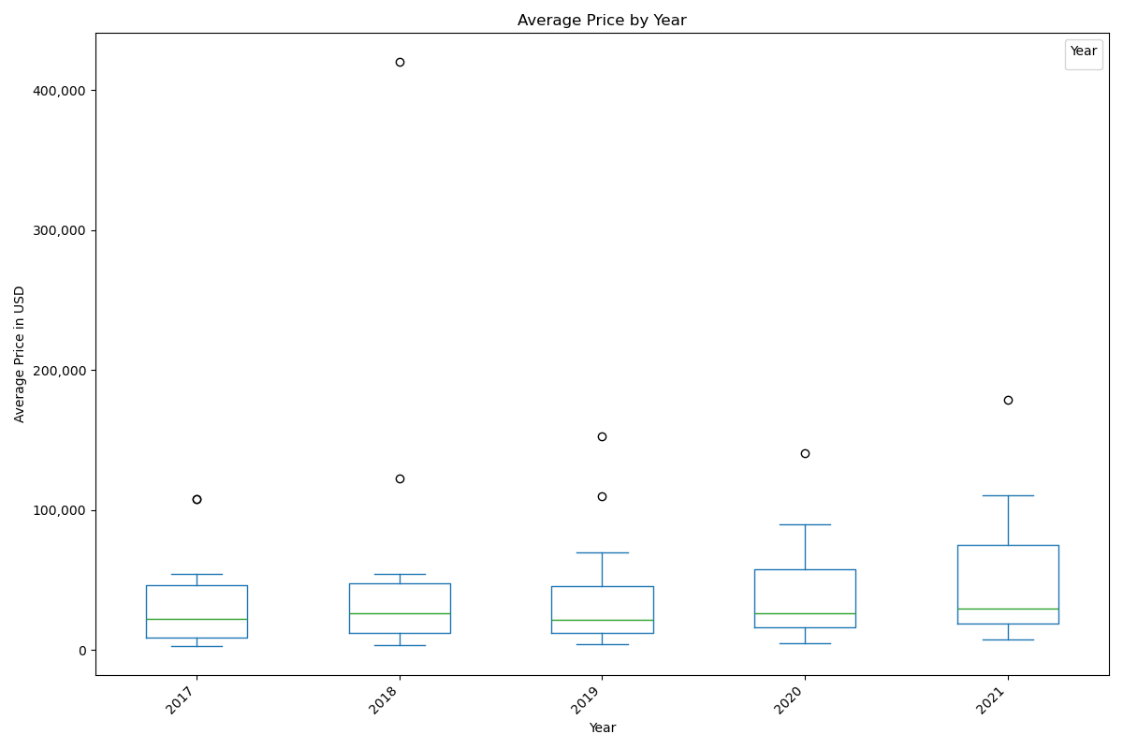
Vehicle Price distribution over time
The largest increase occurs between 2020 and 2021, indicating a significant jump in vehicle prices during that period.
The smallest increase is observed from 2018 to 2019.
The box plot analysis revealed significant variations in average vehicle prices across different years.

Slide 7
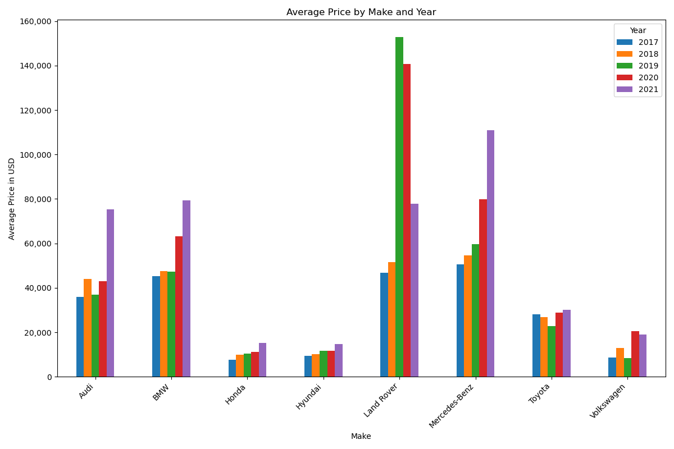
Average price by make and year
Honda , Hyundai, and Toyota show more stable pricing trends over the years, while Volkswagen exhibits more significant fluctuations.
Luxury brands like Audi, BMW, Mercedes-Benz, and Land Rover tend to have higher average prices

Slide 8
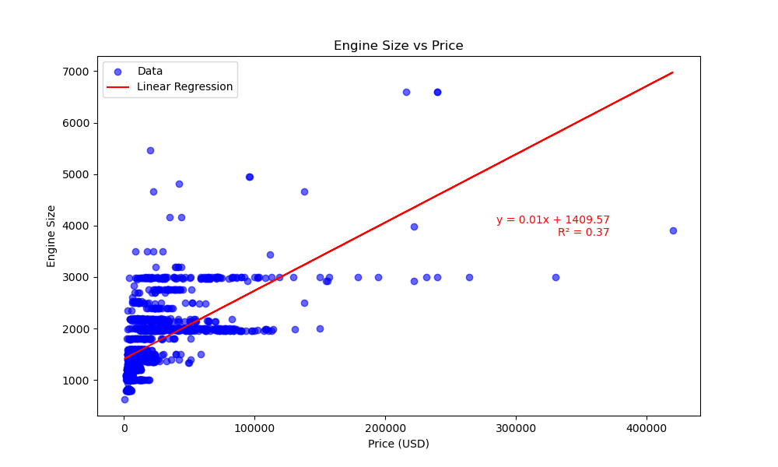
Engine size vs. price
The linear regression map indicates a positive relationship between engine size and price. As engine size increases, there's a tendency for the price of cars to also increase.
This suggests that larger engine sizes are often associated with higher-priced vehicles.
The R-squared value in the regression model shows how much of the price change can be explained by variations in engine size.
The R² value indicates a moderate relationship between the variables.

Slide 9
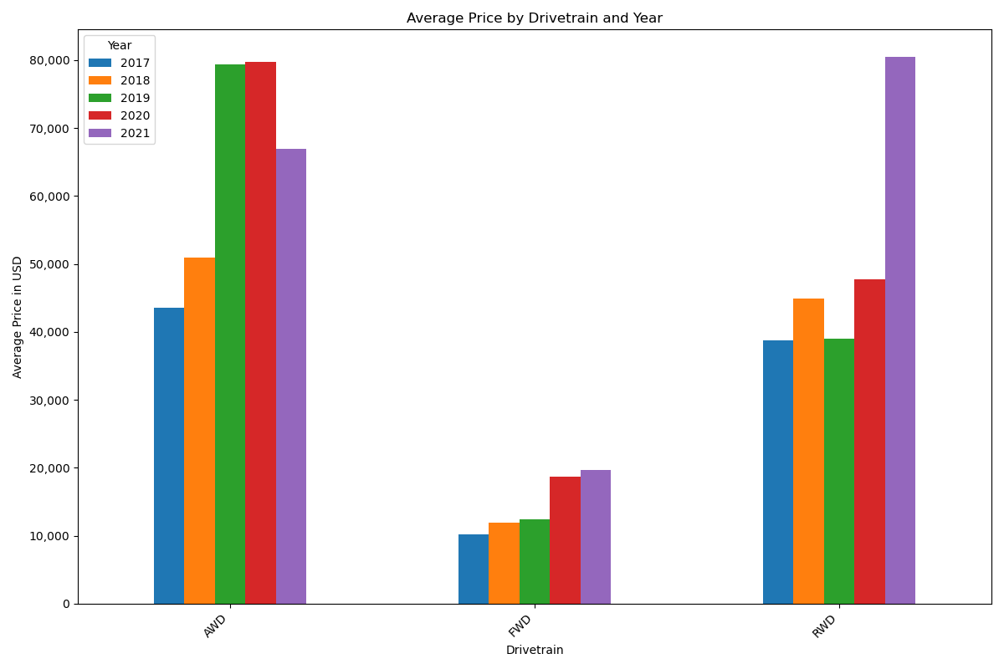
Price by Drivetrain and Year
AWD vehicles consistently commanded higher prices compared to FWD and RWD vehicles, indicating perceived value and market demand for AWD systems.
Prices of AWD and RWD vehicles generally increased over the years, possibly due to technological advancements or changes in consumer preferences.

Slide 10
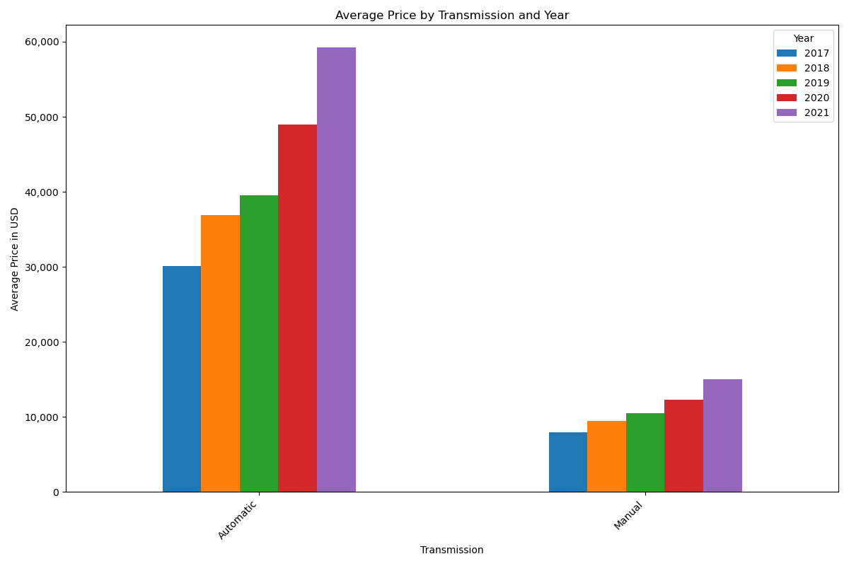
Transmission vs. price
Automatic cars cost more than manual cars most likely because people prefer them and find them more convenient.
Prices for both automatic and manual cars went up over the years, likely because of inflation and changes in the market.

Slide 11
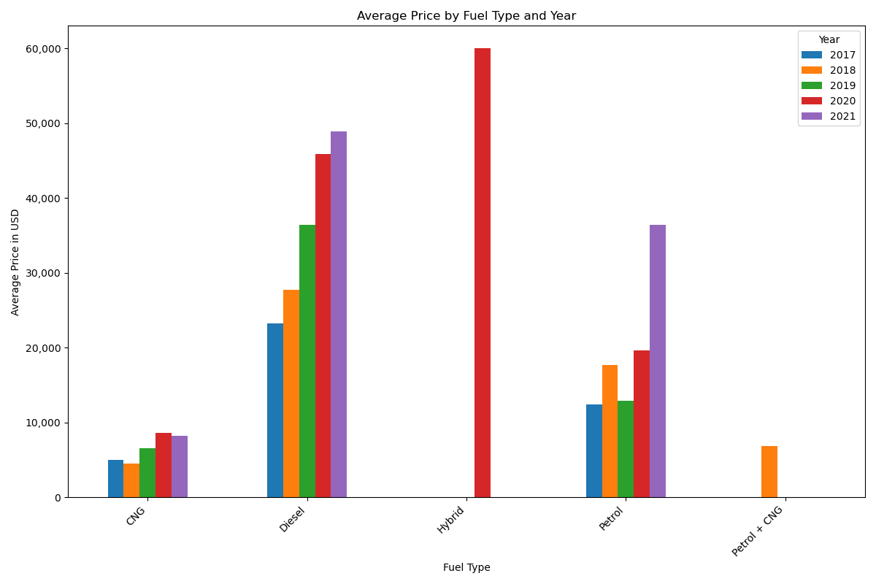
Fuel type vs. price
Diesel vehicles exhibited higher average prices compared to gas and alternative fuel vehicles, likely due to factors such as fuel efficiency and market demand.
CNG Pricing Stability: Compared to petrol, diesel, and hybrid fuels, compressed natural gas (CNG) prices appear to be relatively stable over the years.
This stability might be due to factors such as abundant natural gas reserves, consistent supply chains, or government pricing policies.

Slide 12
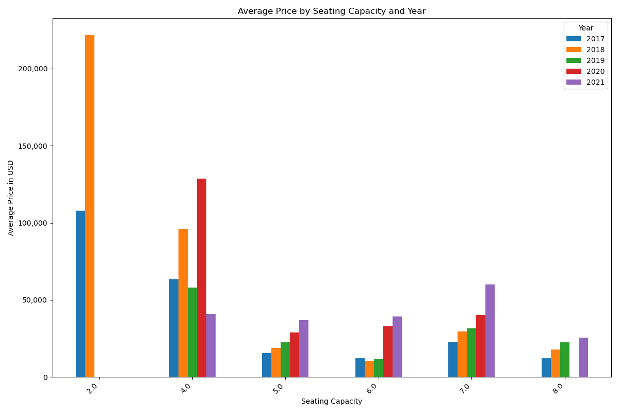
Seating capacity vs. price
Vehicles with less seats, like 2-seaters and 4-seaters, usually cost more on average, showing that smaller vehicles are seen as more valuable.
Prices of 7-seater vehicles showed a significant increase over the years, possibly driven by market demand for SUVs and family-oriented vehicles.

Slide 13

Conclusion and key insights
Price Variation: Significant price variations exist between makes, with premium brands commanding higher prices.
Drivetrain Impact: All-wheel-drive vehicles consistently fetch higher prices, reflecting market demand.
Engine Size vs. Price: A positive relationship exists between engine size and price, indicating a preference for larger engines.
Transmission Trends: Automatic transmissions correlate with higher prices, with an overall increasing price trend.
Fuel Type Dynamics: Diesel vehicles generally have higher prices.
Seating Capacity Influence: Smaller seating capacities correlate with higher prices, especially for 2- and 4-seater vehicles.
Overall, the study highlights various factors affecting vehicle prices, including brand reputation, preferred drivetrains, and demand for seating capacity. This knowledge should help consumers navigate the market, adjust strategies, and take advantage of new trends, ensuring ongoing success in the changing automotive industry.

Slide 14
Q & A’s

Slide 15
THANK YOU
Anna Ramer
annaramer@yahoo.com
Benjamin Fish
benjamin.fish426@gmail.com

